Slide 1
Decoding CEO Backgrounds
By: Samantha Armijo
Notes:
Hello everyone! Thank you for coming to my presentation. I am Samantha and I worked with professor, Peter Haslag, who is part of the Owen school for my capstone project titled Decoding CEO backgrounds.

Slide 2
Agenda
Context
Motivation, The Business Problem & Importance
How We Solved It
Results & Business Implications
Conclusion & Next Steps
Notes:
This is a brief agenda of what we will cover today. So, lets get into it!

Slide 3


Context
The Dynamic Business World
In today’s dynamic business world, CEOs influence beyond traditional leadership roles, significantly shaping organizational dynamics.
The Big 4 Accounting Firms
The Big 4, led by CEOs have expanded into consulting come from an auditing or consulting background.
What does this mean for the rest of the company?
Notes:
In today's business world CEOs not only lead, but also shape the dynamics of the company. Let's imagine this. You are an accounting firm but its not just about number crunching anymore. Your firm now has expanded its divisions into consulting.
That is what has happened with the Big 4 firms, and they are led by CEOs who either have a background in auditing or consulting, so what does this mean for the rest of the company? That is what we’ll get into today by exploring the impact of CEO backgrounds on the operations for 2 firms, Deloitte and EY.

Slide 4



Motivation, The Business Problem & Importance
Motivation
Hiring and retaining talent in the accounting profession poses significant challenges. Why?
Big 4 Firms are expanding there consulting arms.
Problem
Investigate whether a CEO's previous work experience affects how firms operate and whether it contributes to higher turnover in certain segments.
Importance
Provides insight into how resources are allocated within the firm and illuminates the challenges associated with hiring and retaining talent.
Notes:
Hiring and keeping talent in the auditing/accounting profession is not easy. This has been due to generational shifts, changing job perceptions, and competitive wage pressures. But what about this CEO shift in the Big 4 from auditing to consulting? As firms expand there consulting arms does it influence resource allocation, promotions, turnover rates, or other segments in the business?
This is what we wanted to investigate. How does a CEO previous work experience affect different segments like exit rates, job moves within the firm like promotion, demotions, or lateral moves?
The motivation behind this is it gives insight into if CEOs background impacts employee moves or not and can help firms identify if there is differences when this shift happens.

Slide 5
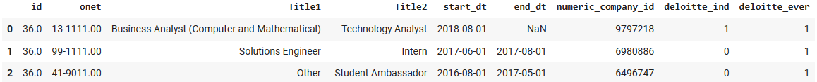
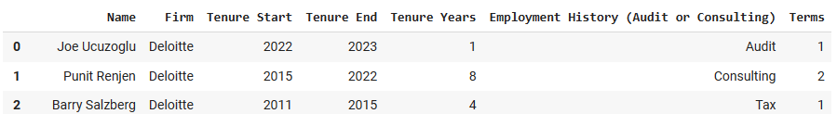
How We Solved It: The Data
Methodology was applied to each firm separately.
Employment History:
Data from individuals employed by firm, encompassing their prior job experiences and roles within either organization.
CEO Information:
Firm CEO data dating back to 1994.
Notes:
2 datasets were used to help solve this question.
First, I used employment data that contained information on the employee’s job role within the firm AND their previous job roles.
Looking at the top snippet you can see I have ID, which is a unique identifier for the person,
ONET, is the occupation code for job titles. This is from the Occupational Information Network which is free online DB that contains job definitions.
We also have job titles, start and end dates for each position, and firm_ind which indicates if this record is within the firm or not.
Second, we used CEO information, at the bottom, that included CEO name, their respective firm, how long they were CEO for, and their background already categorized as auditing or consulting.

Slide 6
How We Solved It: Classification
Classification
Categorized each record as Audit, Consulting, or Other based on ONET code.
Dropped Other labelled rows.
Experience
Numerically calculate years experience for each record in Audit and Consulting based on start and end dates.
Indicator
Assessed years spent in Audit vs. Consulting and assigned True/False labels in the Audit Focus Indicator based on maximum duration.
Notes:
Next, I had to classify each record as auditing or consulting. This was done using only the ONET code because the code should achieve a majority of the indicators from text that fits into one of the categories.
After all rows were categorized, I dropped Other labelled rows.
Next, I had to numerically calculate yrs experience. This was done for each record and based on start and end dates. In some instances, dates were missing so I had to infer the end date of jobs based on the next job start date if there was one or I filled the end dates using today's date.
After the numerical calculation I had to categorize each person as True or False in the audit focused indicator. For example, if ID 2 had 3 records, 1 was categorized as audit with 2 years exp, another was categorized as consulting with 10 years exp and last categorized as audit with 5 years exp. This ID would be false under audit focused indicator because there is more total year exp in consulting.

Slide 7
How We Solved It: Job Analysis
Exit Analysis
Recall: firm_ind, 1 if job within firm, 0 if job outside firm.
Assessed whether their current job was within the firm and if their subsequent job was outside the firm.
Current Job: firm_ind = 1
Next Job: firm_ind = 0
True, Exited
Sorted data frame by start date and ID
Any other combination
False, No Exit
Notes:
The first analysis is the Exit, and these are the steps I took to see if someone exited the firm or not
First, Sorted data frame by start date and ID
Assessed whether their current job was within the firm and if their subsequent job was outside the firm. This was done looking at the start dates. The start date of the next job had to follow the end date of the previous job and firm_ind should be 1 for the first job and 0 for the next job. If this was the case, then the person exited the firm and was labelled true under the new Exit column.
In addition to a new column in the original df, we also created a new data frame. This df grouped occupation and year to calculate the counts of ppl who exited the firm and the total records for each occupation and year. Exit rate was then calculated by dividing the two. This provided insights into the exit patterns of individuals within different occupations and years.

Slide 8
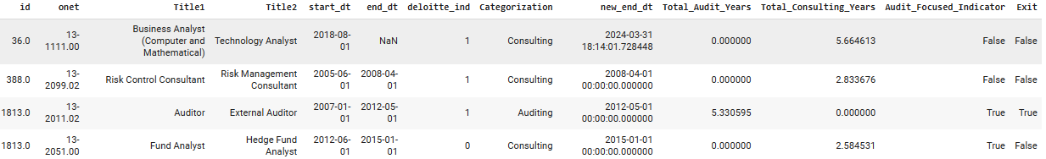
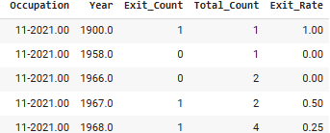
How We Solved It: Job Analysis
Updated Data Frame:
Exit Analysis Data Frame:
Notes:
At the top we can see an updated original data frame. It now includes audit focused indicator, years exp in either category, and the exit label.
At the bottom we can see that new data frame I just talked about which found the exit rate for each occupation and year.

Slide 9
How We Solved It: Job Analysis
Promotion, Lateral, and Demotion Analysis
How employees transition within the firm
Recall: firm_ind = 1 only
Initiated the creation of a new column named 'Origin'
Filtered data to identify transitions between different ONET codes.
Initiated the creation of a new column named ‘Destination’.
Tallied the occurrences of these transitions.
Identify transitions occurring in the opposite direction from destination to origin.
If a reverse transition found, count added to the 'Other Direction' column.
Calculated total number of moves, the sum of direct and reverse transitions, and computed the ratio of direct transitions to total moves, storing the results in the 'Ratio' column.
Notes:
Next analysis is labelling job transitions as either promotion, demotion, or lateral. Since we only care about moves within the firm I filtered the data to only be when firm_ind = 1.
First I created a new column called origin that contained ONET codes and the filtered the data to see if there were transitions between different ONET codes. This column was called destination. We counted the number of IDs that transitioned from origin to destination.
Then we found transitions going in the other direction, from destination to origin. We calculated the total moves which is sum of origin to destination counts and destination to origin counts. Then divided the tally from origin to destination by the total moves. This resulted in a ratio that will be used to label transitions as promotion, demotion, or lateral.

Slide 10
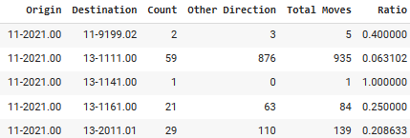
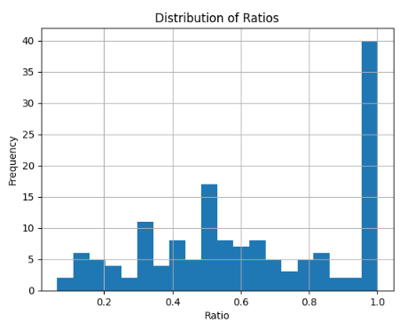
How We Solved It: Job Analysis
Transition Count Data Frame:
Distribution of Ratios to Create Thresholds:
Thresholds
Label | Ratio
Demotion | 0.0 - 0.35
Lateral | 0.36 - 0.74
Promotion | 0.75 - 1.0
Notes:
Here we can see a new data frame that contains what I just talked about, the origin destination, tallies, and ratios.
After getting the ratios I created a distribution of the ratios to help pick the thresholds for labelling.
From the slide you can see the thresholds we set for labelling

Slide 11
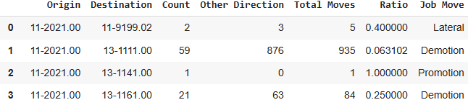
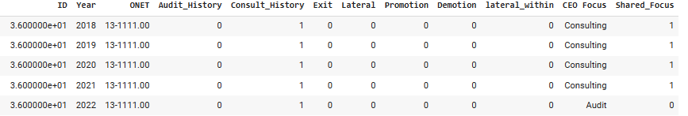
How We Solved It: Job Analysis
Notes:
Now I am left with two data frames, the original with Exit column and the transitions df with labelled thresholds. I was able to union the two data frames. For the first df I had to create a new column, called next occupation, so I could union origin with onet and destination with next occupation.
After doing some magic and transposing the data I ended with the final dataset at the bottom that was used for the regression analysis.
You can see in the final dataset there are some new variables like lateral within and shared focus. Lateral within is just another type of job transition, it is when a person makes a lateral move within the company and shared focus variable is the identifier IF the employee history, audit or consult, matches the CEO focus at that time.

Slide 12
Results & Business Implications
Regression Analysis Results – Deloitte
Dependent Variable | Statistically Significant, p-value < 0.05 | NOT Significant, p-value > 0.05
Exit |  | X
Lateral | X (negative)
Promotion | X (negative)
Demotion | X (negative)
Lateral-Within | X (negative)
Notes:
Using that final dataset, I ran a regression analysis for each firm. This is the Deloitte results for the shared focus variable.
We homed in on this variable because it tells us if there is an alignment in focus between the employee and CEO.
We can see that for Deloitte there is statistical significance in several variables. These coefficients imply that an increase in shared focus correlates with a decrease in the likelihood of experiencing the listed dependent variables.

Slide 13
Results & Business Implications
Regression Analysis Results – EY
Dependent Variable | Statistically Significant, p-value < 0.05 | NOT Significant, p-value > 0.05
Exit |  | X
Lateral |  | X
Promotion | X (positive)
Demotion |  | X
Lateral-Within |  | X
Notes:
As for EY looking at the shared focus variable, we see the opposite. The only variable impacted by shared focus is Promotion. This implies an increase in shared focus correlates to an increase in promotions.
These findings offer insights into the dynamics of employee movements within the firms and sheds light on the potential impact of CEO backgrounds on organizational outcomes.

Slide 14
Results & Business Implications
Results
Variations in results highlight possible organizational dynamics.
Deloitte shows significance across multiple variables: lateral movements, promotions, demotions, while EY's results focus solely on promotions.
Differences can be attributed to organizational culture and leadership styles.
CEO background alignment influences employee transitions.
Negative coefficients in Deloitte's regression: 'shared focus' decreases likelihood of movements in lateral, promotion, and demotions movements .
Positive coefficient in EY's regression: 'shared focus' increases likelihood of promotions.
Business Impact
Implications for Deloitte and EY's business strategies and operations.
Crucial insights into employee movements and CEO backgrounds.
Actionable insights for HR and executive leadership teams.
Optimize workforce allocation, tailor retention efforts, align priorities with CEO backgrounds.
Notes:
The difference in the results between the two firms was surprising but it can tell us there could be differences in organizational culture, leadership styles, and strategic priorities between the two firms. Deloitte's broader significance across various dependent variables may reflect a more pronounced influence of CEO background alignment on employee transitions within the organization compared to EY.

Slide 15
Conclusion & Next Steps
Next Steps
Broaden analysis by including more accounting firms to uncover patterns across dependent variables.
Integrate qualitative research methods like interviews or surveys with employees and executives.
Gain deeper insights into subjective experiences and perceptions.
Impact
Deepen understanding of CEO background impacts.
Inform evidence-based strategies for enhancing organizational effectiveness in professional services sector.
Notes:
Some next steps for this project is to run the same analysis on different firms to see if there are patterns in the dependent variables.
Another idea is to get more qualitative data and do interviews and surveys on these firms. This can help us better understand subjective experiences.
These additions can deepen our understanding of how CEO backgrounds impact exit rates, promotions, demotions, and more.

Slide 16
Thank you!
Questions.
Notes:
Thank you, Questions!

